Slide 1
JSON
Best practices

Slide 2
Introduction
JSON - javascript object notation
JSON is a lightweight data-interchange format that is completely language independent
The official internet media type for JSON is application/json
Human readable data interchange
So, for security, JSON is encrypted and decrypted
Uses of JSON
JSON format is used for serializing and transmitting structured data over a network connection
Primarily used to transmit data between a server and web application
Web services and APIs use JSON format to provide public data

Slide 3
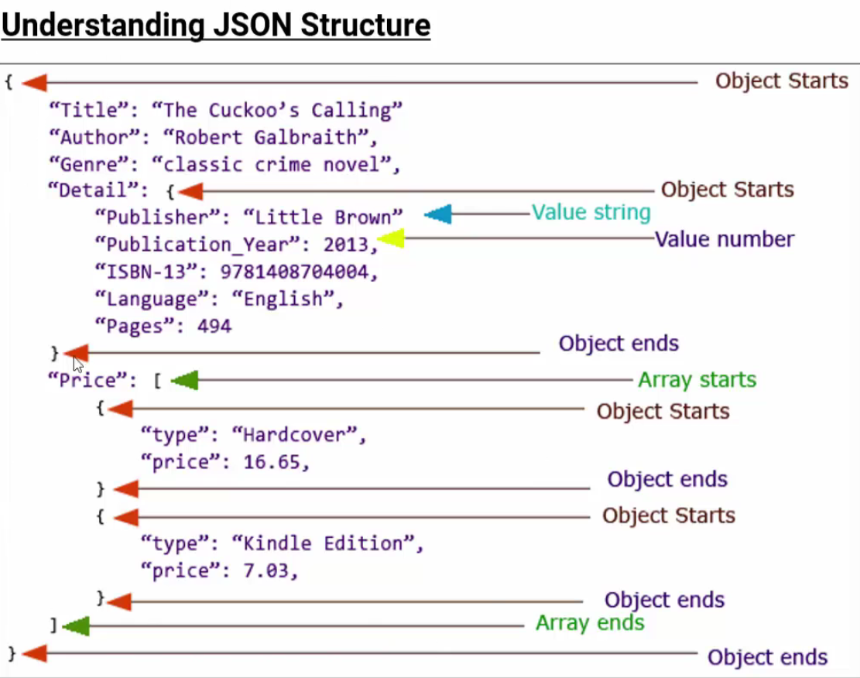
JSON Structure

Slide 4
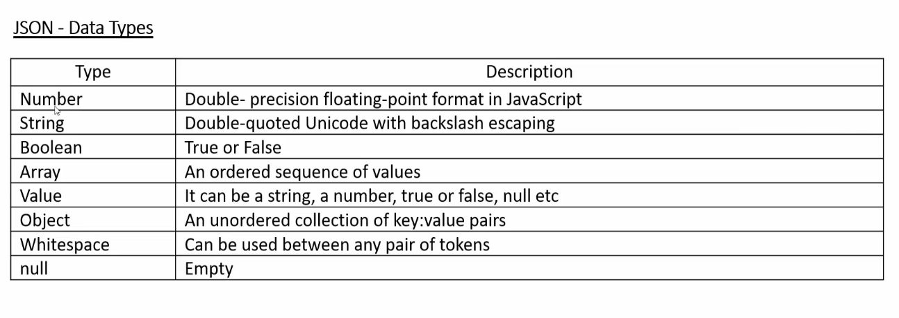
JSON Data Types

Slide 5
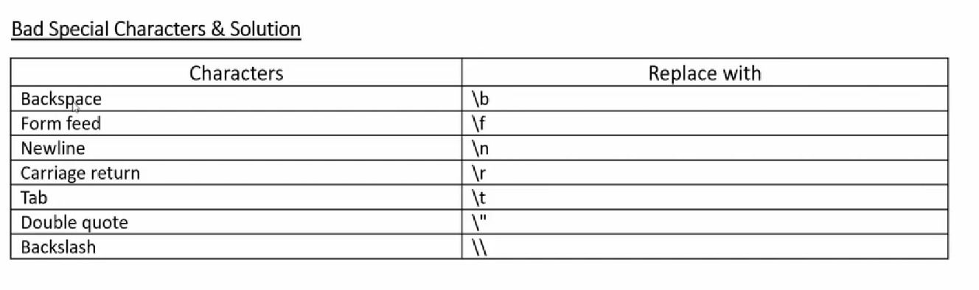
Bad Characters and Solution
JSON Lint website to validate JSON data and finding error in JSON

Slide 6
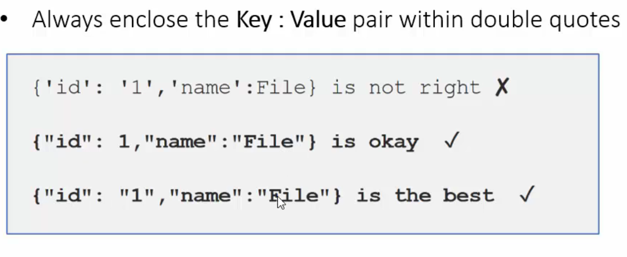
Key: value

Slide 7
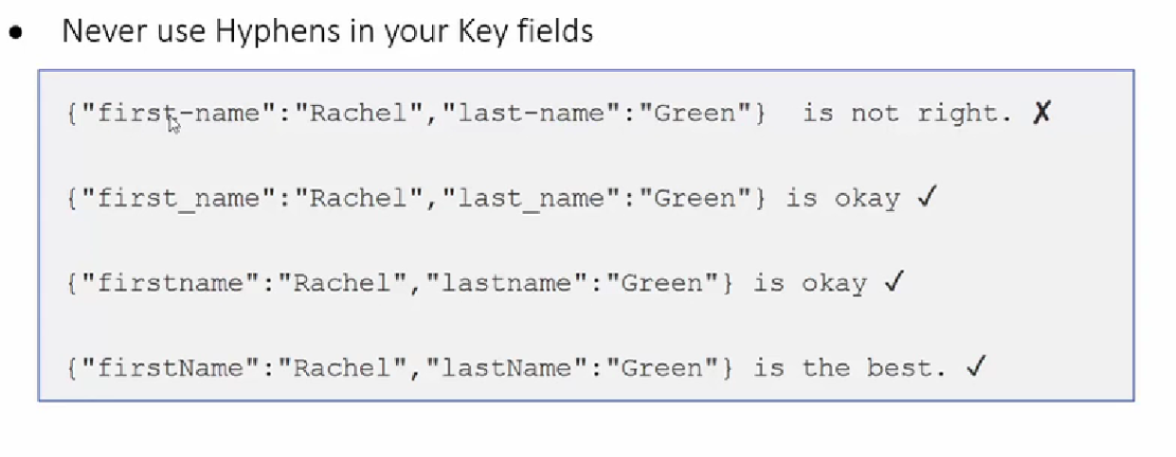
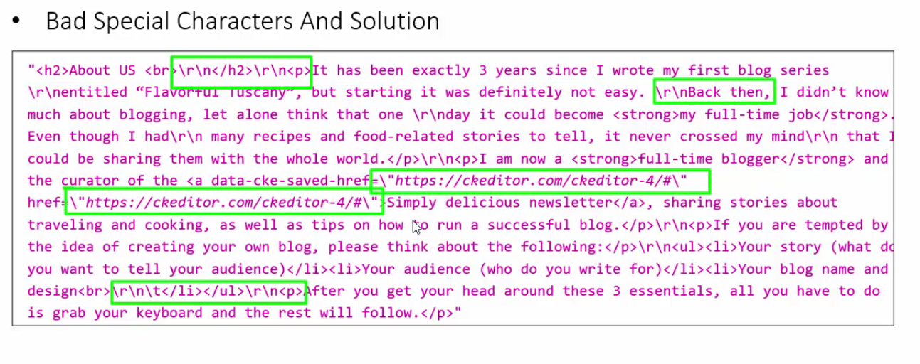

Slide 8
